Slide 1

Experts in Coaching, Training and Motivational Speaking
http://www.elantattva.com/

Slide 2
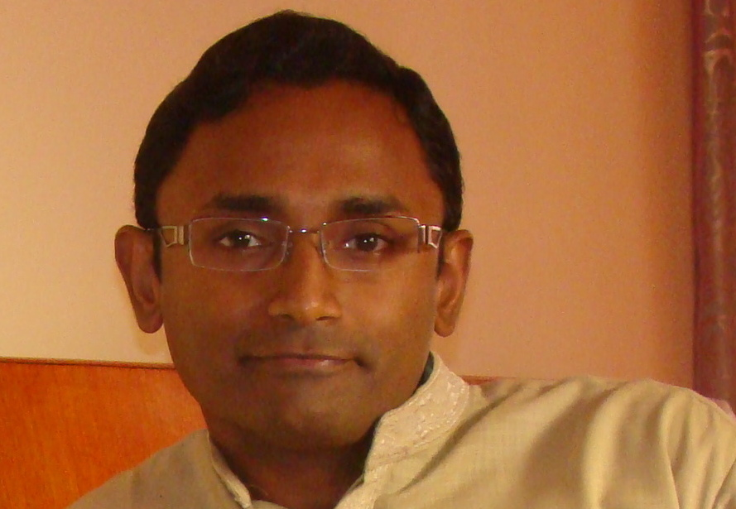
Our Lead Team
Suresh Sivaraman
Executive Coach & Trainer
Over 16 years of experience in corporate life.
Certified Coach (Neuro Leadership Group, and ANLP India)
Co-Founder of Elan Tattva, which is into personal excellence training & coaching
MBA (PGSEM) from IIM Bangalore, Class of 2006
Delivery Manager in Wipro Technologies till 2011
Extensive work experience in India and Europe

Slide 3
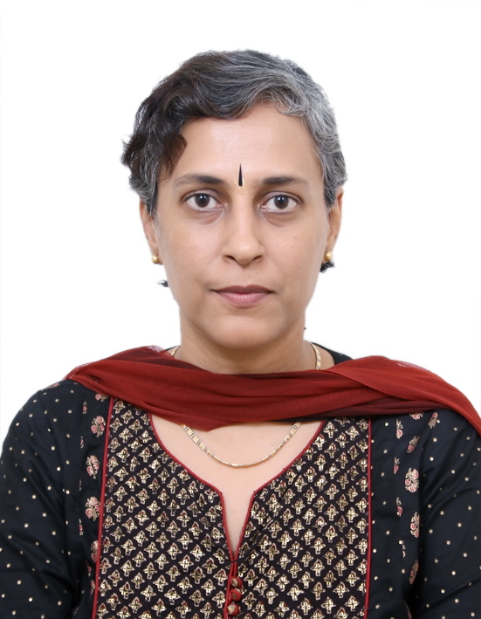
Our Lead Team
Archana Krishnamurthy
Motivational Speaker and Certified Leadership Coach
Over 22 years of experience in corporate life.
Has been an entrepreneur for over 12 years.
Is certified by Franklin Covey Institute, Australia as Leadership Coach.
Is Founder Director of CorNet PR - which is into Corporate Networking and servicing M&E segment.
Works closely with Governments and Trade & Industry Associations in various senior positions.
Presentation for Corporate Organizations

Slide 4
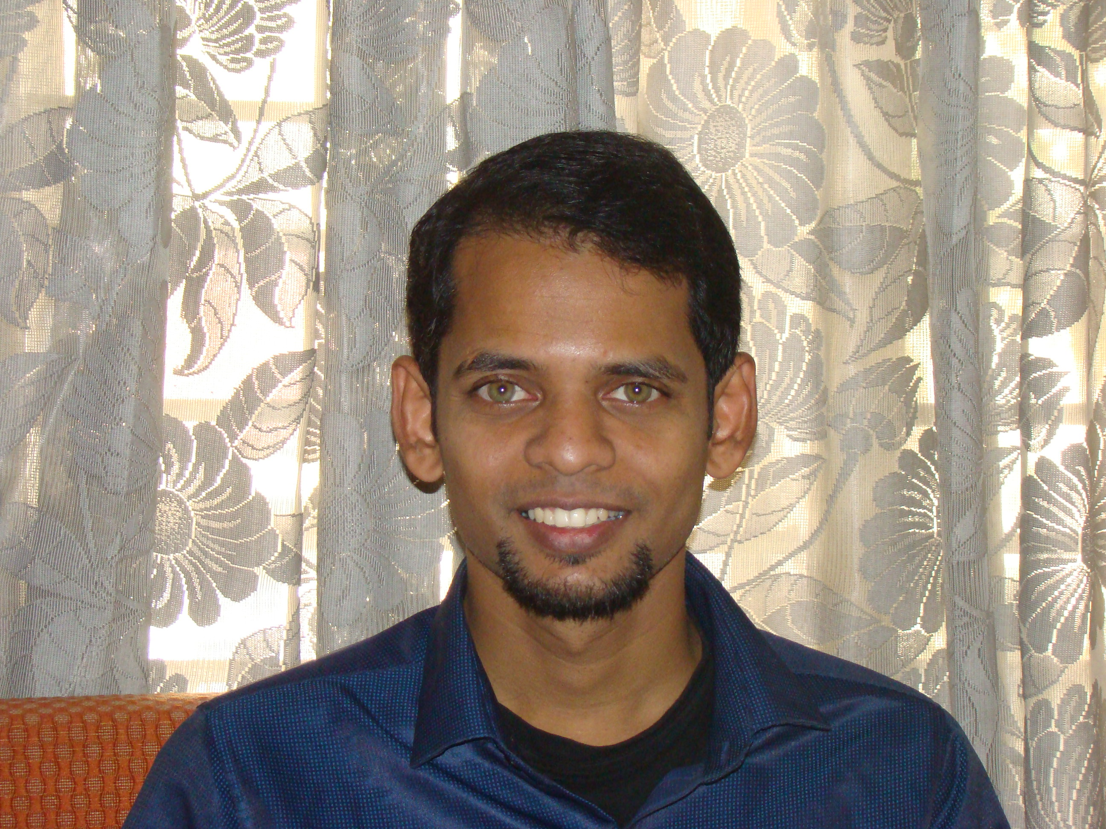
Our Lead Team
Corporate Trainer, Entrepreneur
Raphael Joseph
Corporate Trainer in Leadership, Behavioural & Sales with varied industrial experience
Asst. Team lead in Technicolor India from (Jan 2006 – Oct 2012); was picked as the star performer of gaming unit 2011 – 2012
Guest Lecturer and Mentor for ‘Arena Multimedia’ and ‘Image Multimedia’
Actively partnered with YMCA in organizing youth camps, and drug de -addiction camps
Organized youth empowerment programs
Rich philosophical and psychological back ground

Slide 5
Our Lead Team
Kiran Shetty
Kiran Shetty (Co-Founder of Elan Tattva, Certified Teacher/Trainer of Yoga [Bihar School of Yoga, SVYASA Yoga University, Bangalore, Martial Arts Expert, Coach).
Kiran has done his MBA from Mangalore University, and Advanced Marketing Management from IIM-Kozhikode.
His passion for health and fitness led him to take a career break and further explore the world of yoga. Practicing Yoga for the last 10 years, he has experienced a profound sense of wellbeing i.e., physical, mental and emotional. His journey into yoga is a natural progression from Martial arts. He started learning martial arts since the age of 16. He has realised that martial arts and yoga have a lot in common; they make one calm and gentle, yet intensely aware and strong.
His credentials in Yoga and Martial Arts include:
Yoga Instructors Course from SVYASA Yoga University, Bangalore Teachers Training Course, Bihar Yoga School, Bihar (World’s first Yoga University) Post Graduate Diploma in Yoga Therapy, SVYASA Yoga University, Bangalore Black Belt 3rd Dan in Karate and medal winner at National Karate tournament Certification course in Psychology from Indian Psychology Institute, Pondicherry.

Slide 6
Our Lead Team
Kabir Ahluwalia
Kabir Ahluwalia (Co-Founder of Elan Tattva, Certified NLP Master Practitioner [ANLP India], Certified Advanced Life Coach [ANLP India], Psychotherapist, Intuitive Card Reader, Graphologist, Pranic Healer and Spiritual Counsellor.
Kabir is a successful Hotelier and Entrepreneur in Travel & Tourism Industry. He has corporate industry experience from 2007 onwards. Along with his business/professional commitments, he has pursued his deep passion in coaching, counselling and therapy. His key offerings in these areas include Outcome focused Counselling (a new and increasingly used therapeutic approach that focuses on helping clients construct solutions rather than solve problems), LIFE ENERGY PATHWAY REPROGRAMMING (LEPR) which involves reprogramming the brain and removing the blockages from the energy pathways (allowing the body to regain perfect balance and function normally and to reach optimum health), Spiral Personality Type Counselling (Helping individuals understand themselves with spiral personality colour coding).

